Slide 1
Data Science Sandbox/Platform – R
Preetam Balijepalli
ML Solution Archictect
28/02/2020

Slide 2
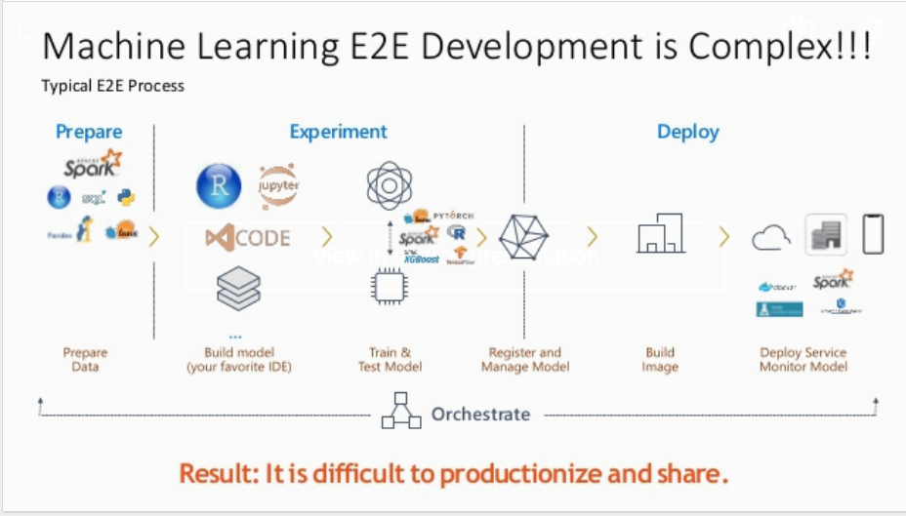

Slide 3
Current RStudio Server Open Source Edition - Glaring issues with this installation:
RStudio Server doesn’t know about LDAP users or any users not directly on the server (i.e. any users not created with useradd).
RStudio is being hosted over a non-standard port (8787).
The website is being served over HTTP - any passwords entered/network traffic will be in plain-text. This is BAD.
There are no resource limits for users. There’s a known bug in RStudio (both Pro and Open Source Edition) where loading >10GB of data into a session will lock that user out of RStudio indefinitely. (RStudio will try to save large sessions to disk, then time out while attempting to re-load them).
We might want to host RStudio as part of another website (for example, https://your.website.name/rstudio/).

Slide 4
Authentication : Current and Future
Current
AWS IAM configuration
RStudio Server uses PAM for authentication. PAM (Pluggable Authentication Modules)
Future
We’ll need to change RStudio’s PAM authentication. To change authentication methods, say from UNIX users to LDAP
Hosting RStudio Server securely over HTTPS behind a webserver like Apache httpd or Nginx in what’s called a reverse proxy configuration.
New Apache VirtualHost that exposes RStudio to the web. You’ll need an SSL certificate for this step
Redirect from HTTP and force HTTPS automatically if someone tries to visit the HTTP link.
Set up resource limits (this will also prevent one user from dominating all the memory on the system, of course). May be memory limit of 7.5GB for all human users on the system.
Load-balancing across multiple servers

Slide 5
Large and Distributed , Complex Processing
Challenges
Scalability
Privacy and security of data
Ability to connect R workflows with other tools (Spark, Tensorflow etc.)
Possibilities
RStudio on Kubernetes (OpenStack) + Training and Deployment Jobs with Kubeflow
Sagemaker (with the help of ‘reticulate’ python package)
Serverless – Lambda (Job should be < limitations of RAM and Execution Time)

Slide 6
Model Serving :
Deployment
User and API authentication
Manage the domain
Certificate manager for SSL certificates
Auto Scaling
Load Balancing

Slide 7
Reference:
Pro Vs Open Source
https://rstudio.com/products/rstudio-server-pro/comparison/
https://jstaf.github.io/2018/06/20/rstudio-server-semi-pro.html
AWS Sagemaker
https://timmastny.rbind.io/blog/aws-sagemaker-r/#aws-cost
https://www.rpubs.com/TimFlocke/SageMaker_R_demo
https://aws.amazon.com/blogs/machine-learning/using-r-with-amazon-sagemaker/
AWS Lambda
https://medium.com/bakdata/running-r-on-aws-lambda-9d40643551a6
https://dashbird.io/blog/exploring-lambda-limitations/
https://docs.aws.amazon.com/lambda/latest/dg/gettingstarted-limits.html

Slide 8


Thank You !

